Slide 1
Linguistic Wordle
By Veronika Rapp and Jonas Patzke

Slide 2
Research Question
Which linguistic features provide the most effective support for players when guessing a hidden target word in a Wordle-like game?

Slide 3
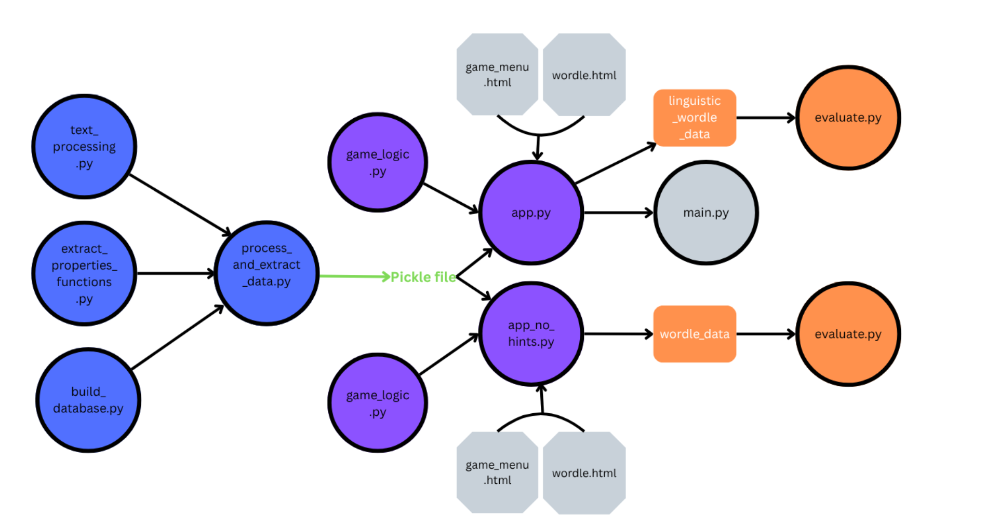
4 Steps

Slide 4
1st step
Text processing
-extract the first 20 chapters
-tokenize
-remove stop words
-remove proper names
-lemmatize
-solve edge cases
-only use words we can get the syllables of

Slide 5
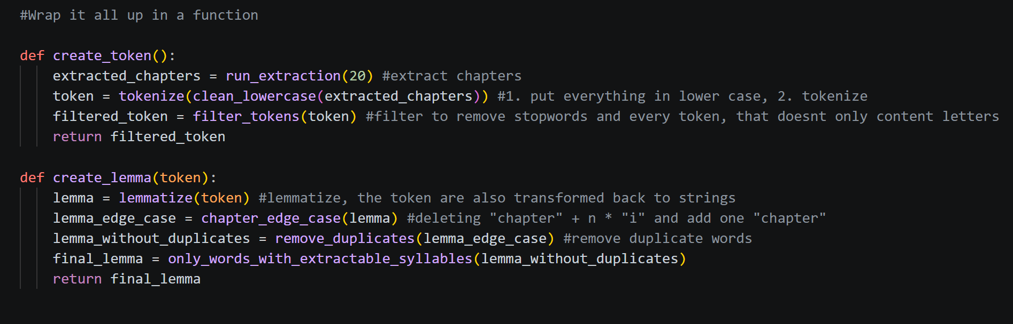

Slide 6
2nd step
Extracting the linguistic properties
-POS
-length
-syllables count
-word frequency

Slide 7
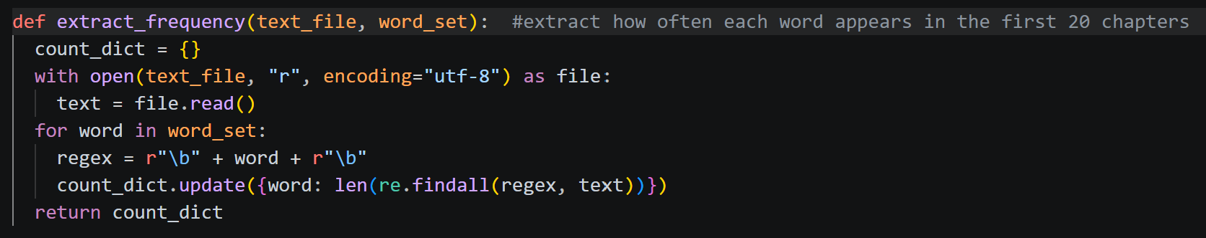
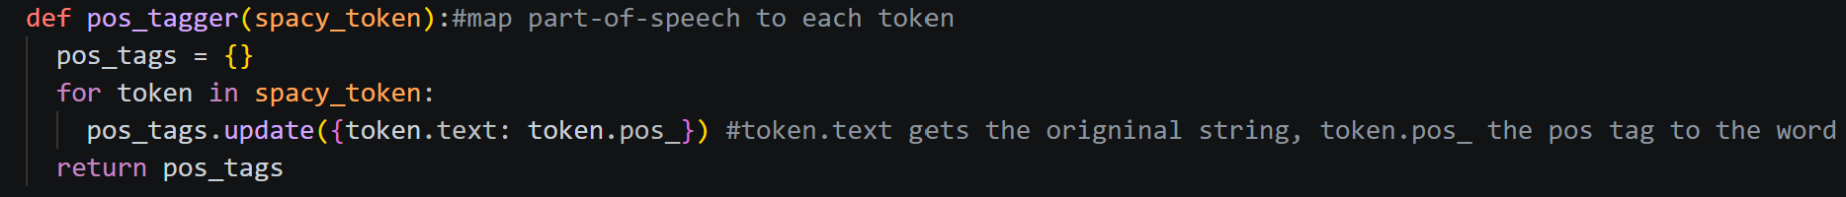

Slide 8
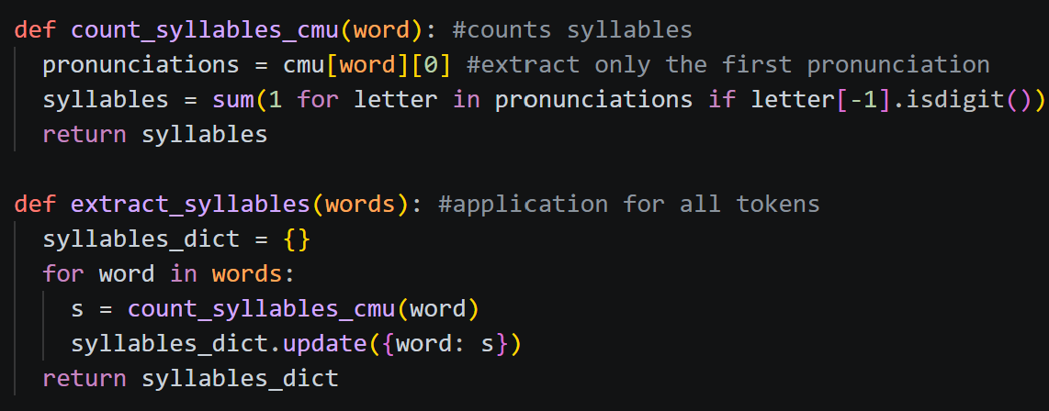
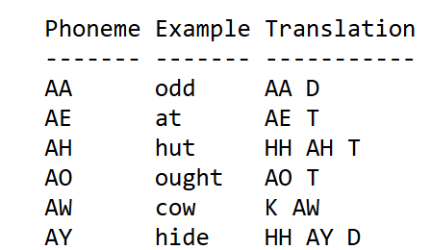
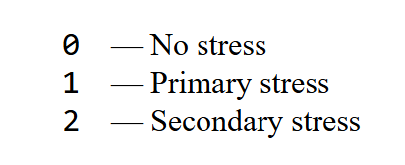

Slide 9
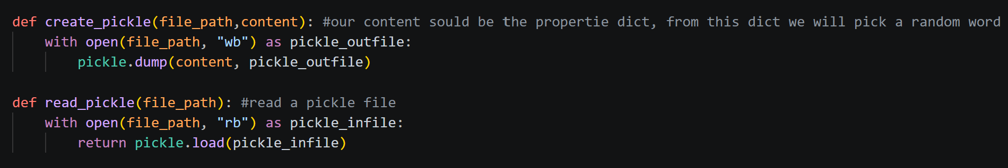

Slide 10
3rd step
Implementing the game logic and the HTML gui
-write the design in HTML and CSS
-connecting the frontend with the backend over Flask
-write functions to implement logic
-choose a random word as solution
-run code on each guess and return hints

Slide 11
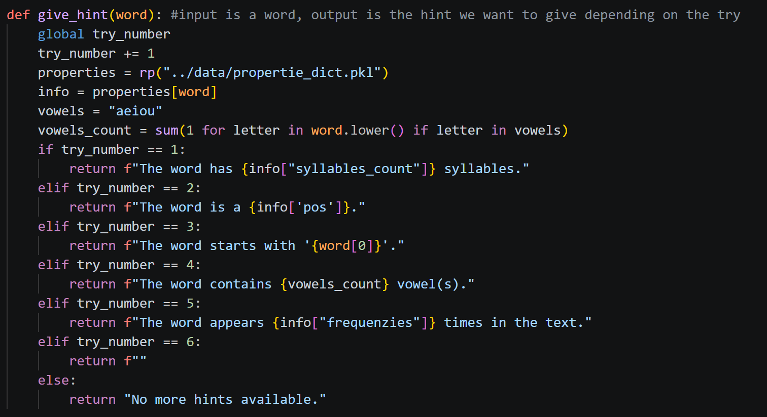

Slide 12
4th Step
Collecting and Evaluating Data
-playing wordle and collect data
-write analysis functions
-analayse charts and interpret

Slide 13
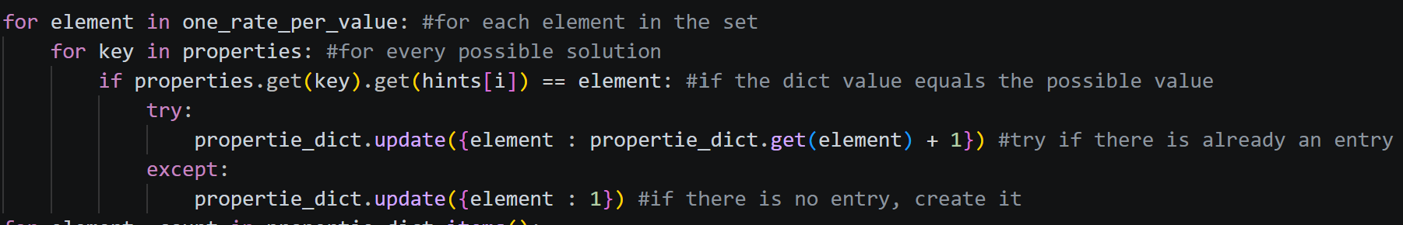

Slide 14
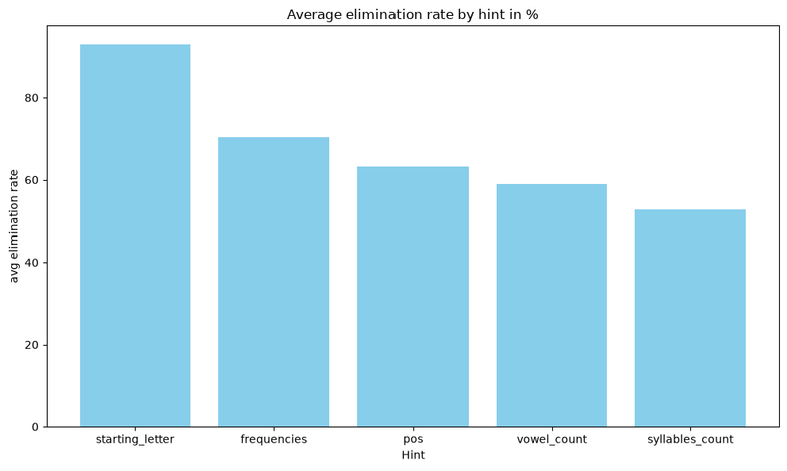

Slide 15
Linguistic Wordle
Wordle without hints

Slide 16
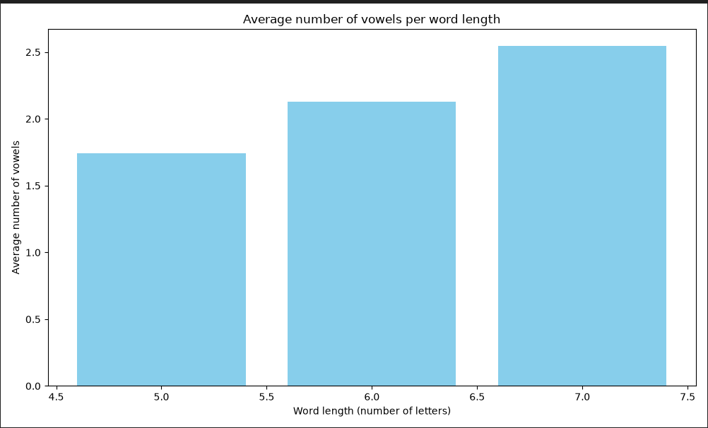

Slide 17
Conclusion
Measurable differences between both wordle games
More time, more wins, less tries in Linguistic Wordle
Per elimination rate most efficient:
  Starting letter
  Frequencies
  POS

Slide 18
Thank you for listening
Are there any questions left?

